Slide 1

CZ2101
Example Class 3
Team Member
Benjamin Goh (U2022728L)
Isaac Tan (U2020337B)
Jiang Yuxin (U2022749J)
Nov 02, 2021
1

Slide 2
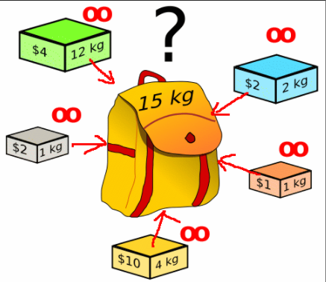
Project 3: Dynamic Programming
Unlimited Supplies of Objects
Recursive definition of P(C)
Subproblem Graph
Dynamic Programming Algorithm
Implementation & Output

Slide 3
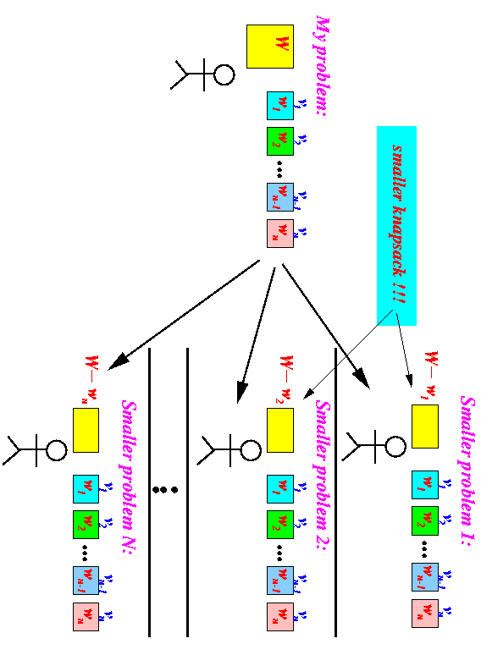
Recursive Definition of P(C)
P(C): the maximum profit that can be made by packing objects into the knapsack of capacity C
p[i]: profit of i-th item
P(C) = max( P(C-w[0]) + p[0],
P(C-w[1]) + p[1],
….
P(C-w[n-1]) + p[n-1]
)

Slide 4
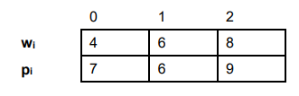
Recursive Method: Subproblem Graph
W = 14
n = 3
p = 0
i0
i2
i1
W = 10
n = 2
p = 7
W = 8
n = 2
p = 6
W = 6
n = 2
p = 9
i0
i2
i0
i2
i1
i1
i1
i0
W = 6
n = 1
p = 14
W = 4
n = 1
p = 13
W = 2
n = 1
p = 16
W = 4
n = 1
p = 13
W = 2
n = 1
p = 12
W = 0
n = 1
p = 15
W = 2
n = 1
p = 16
W = 0
n = 1
p = 15
i0
i1
i0
i0
W = 2
n = 0
p = 21
W = 0
n = 0
P = 20
W = 0
n = 0
p = 20
W = 0
n = 0
p = 20
Notes:
As shown by the subproblem

Slide 5
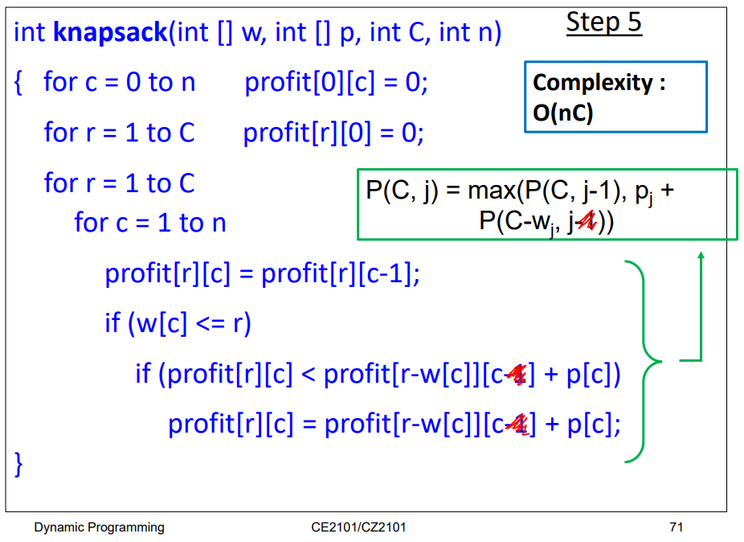
Dynamic Programming Algorithm

Slide 6
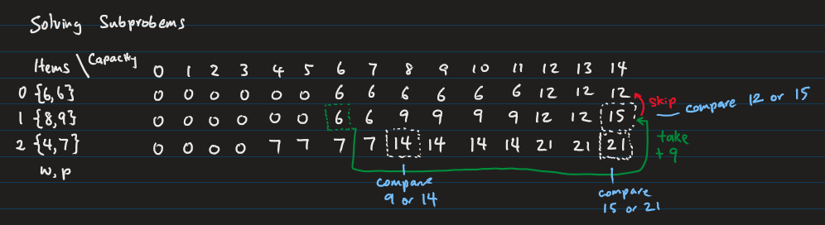
Dynamic Programming Algorithm

Slide 7
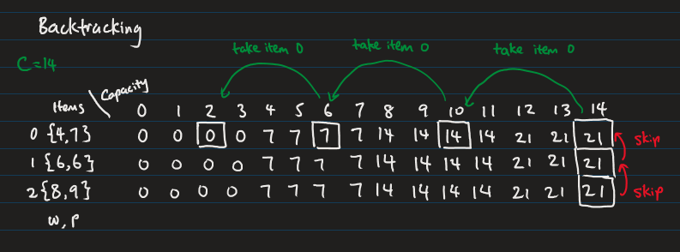
Dynamic Programming Algorithm

Slide 8
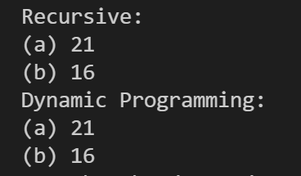
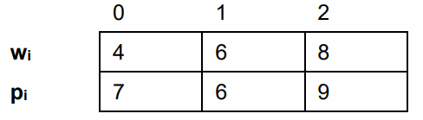
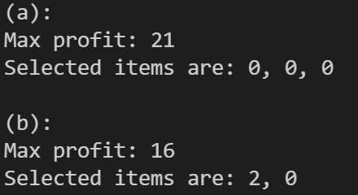
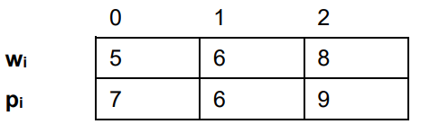
Code Implementation & Results
(a)
(b)

Slide 9

THANK YOU FOR YOUR TIME!

Slide 10
CZ2101
Example Class 2
Team Member
Benjamin Goh (U2022728L)
Isaac Tan (U2020337B)
Jiang Yuxin (U2022749J)
Sep 14, 2021
1

Slide 11
Project 2: Dijkstra’s Algorithm
Implement & Analyze Dijkstra’s Algorithm (a)
graph representation: Adjacency Matrix
priority queue: Array
Implement & Analyze Dijkstra’s Algorithm (b)
graph representation: Adjacency List
priority queue: Minimizing Heap
Compare CPU time of (a) and (b)
Notes:
Our presentation is simply divided into three parts, first two, we will introduce the implementation and analysis of Dijkstra’s algorithm using different graph representation and the priority queue. then compare the CPU time of these two implementations.

Slide 12
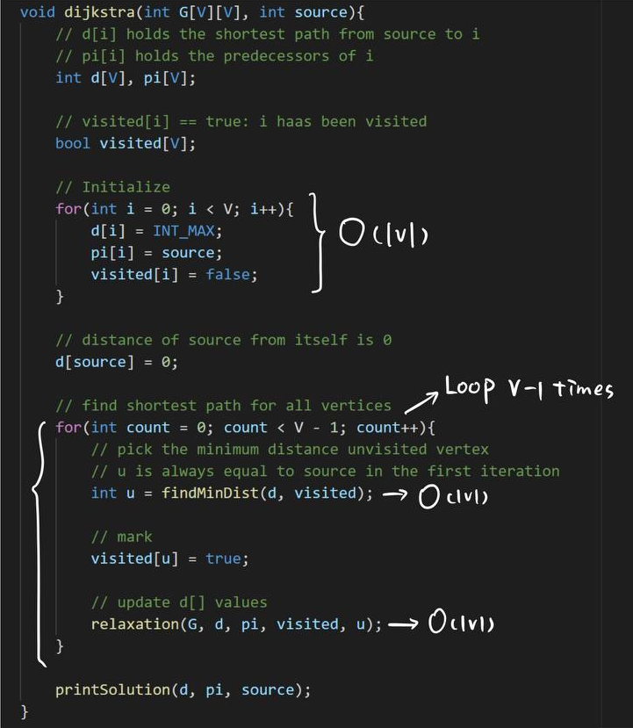
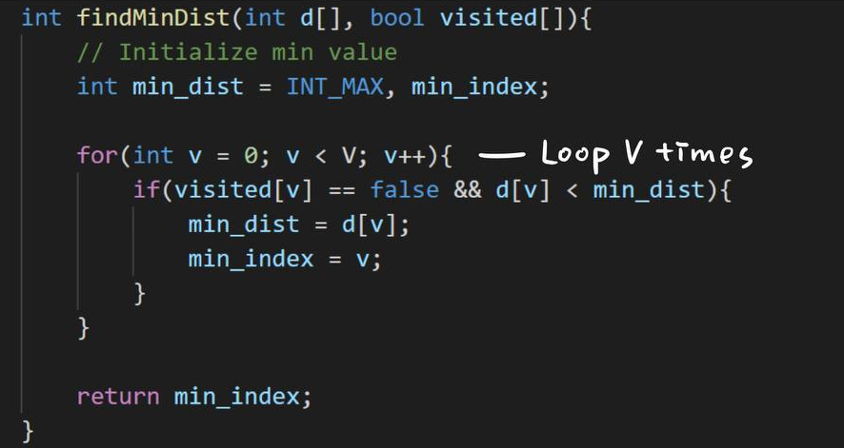
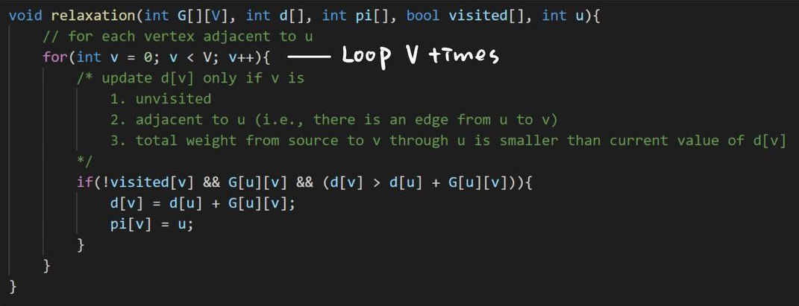
1. Implement & Analyze Dijkstra’s Algorithm (a)
Notes:
So in the first setting, we use a naive way to get the vertex with minimum distance, a linear seach, which just simply scans the whole distance array. It loops V times. V is the number of vertices in a graph. For each neighbor of the minimum distance vertex, time taken for updating the distance is constant time and there will be maximum V neighbors. As shown here, we loop V times. Therefore, Time taken for each iteration of the loop is big O(V) and it loops total V-1 times.

Slide 13
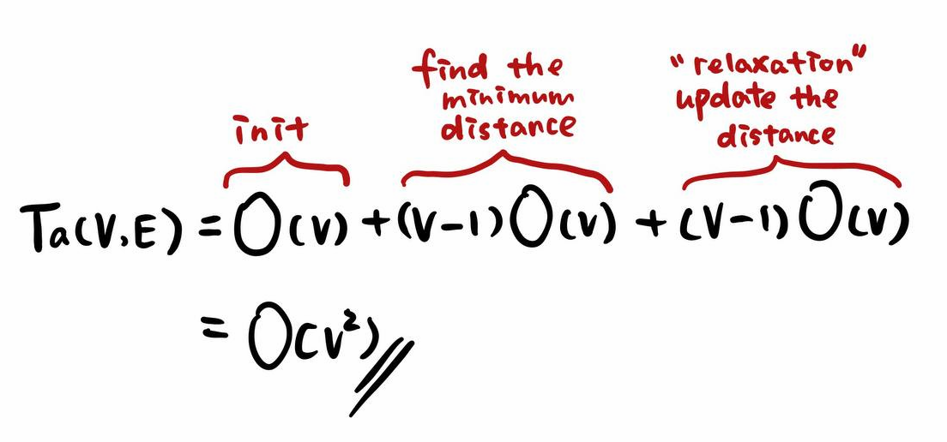
1. Implement & Analyze Dijkstra’s Algorithm (a)
Notes:
Thus, adding these three parts, total time complexity becomes O(V^2). We can see that its time complexity has nothing to do with the number of edges.

Slide 14
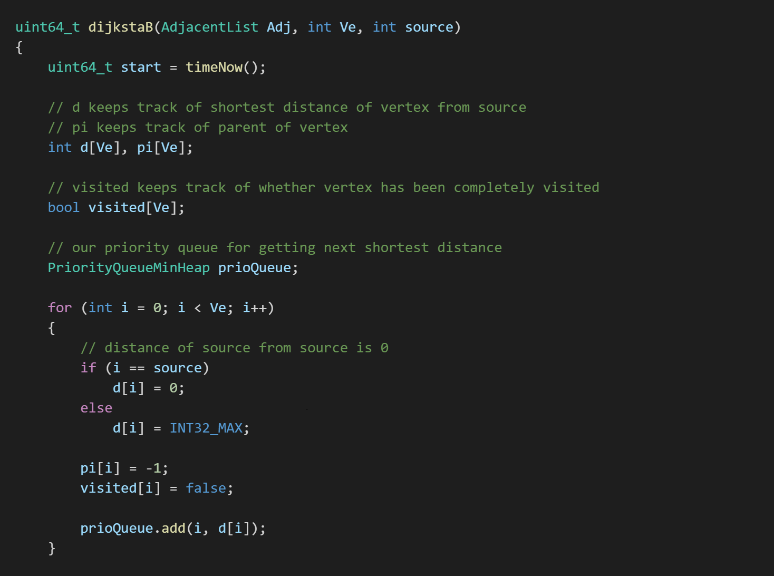
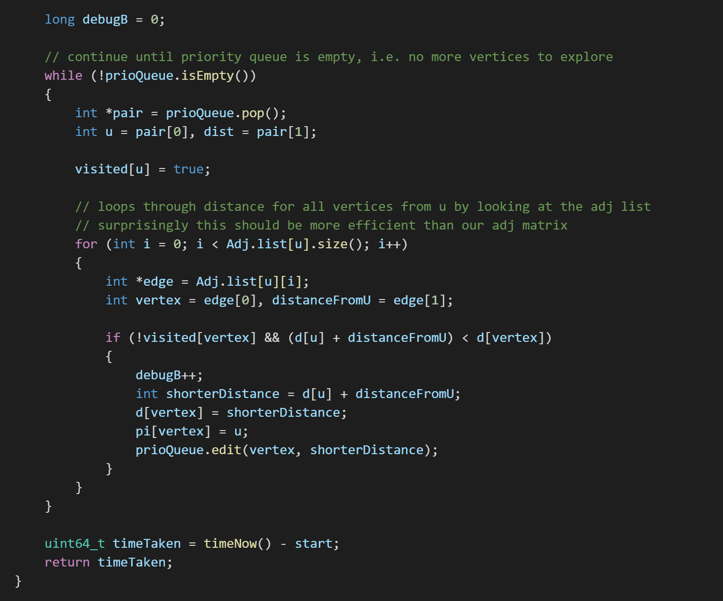
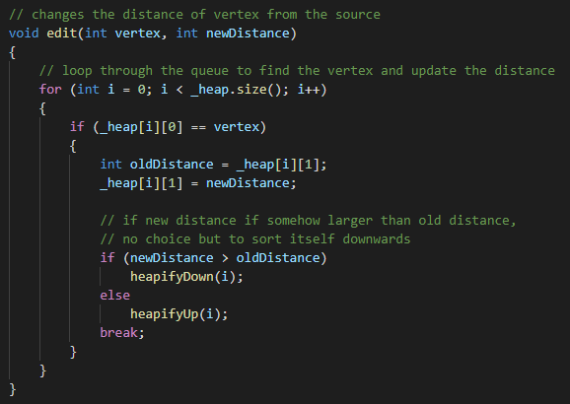
2. Implement & Analyze Dijkstra’s Algorithm (b)
Loop V Times
O(logV)
Loop E times max
O(V)
O(V+logV)

Slide 15
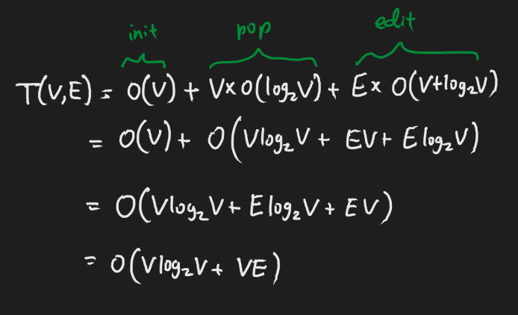
2. Implement & Analyze Dijkstra’s Algorithm (b)

Slide 16
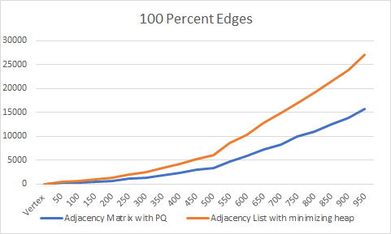
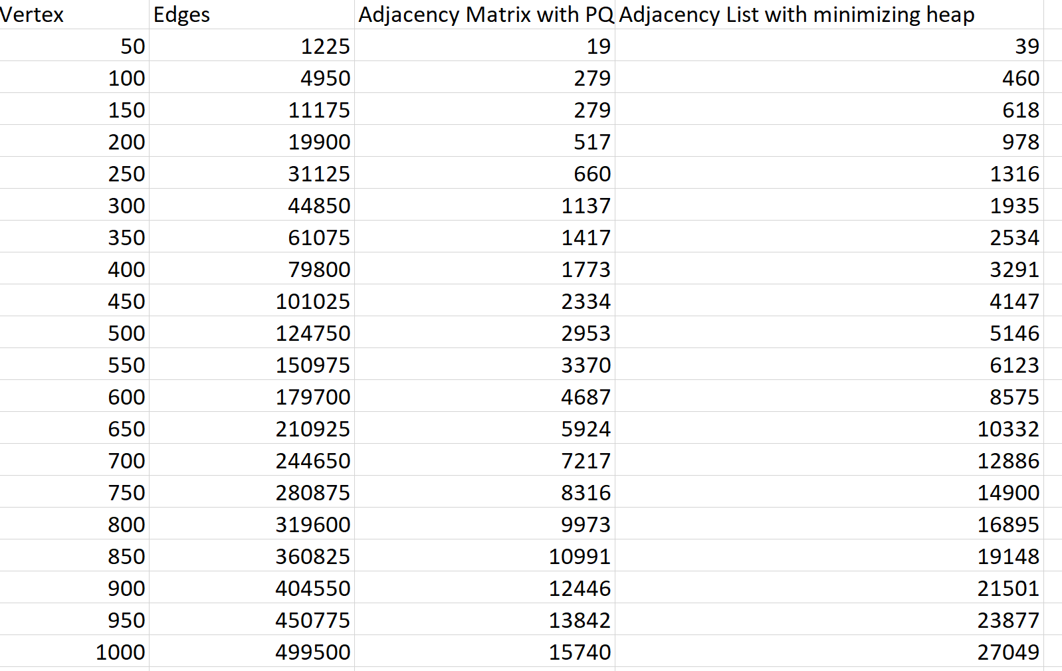
3. Comparing the CPU runtimes between part (a) and (b) with regards to number of edges and vertexes
Runtime is shown in Microseconds
As the graph goes on, the number of edges increases as well
Notes:
The percentage shown is as per the total number of edges possible

Slide 17
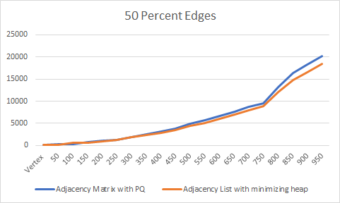
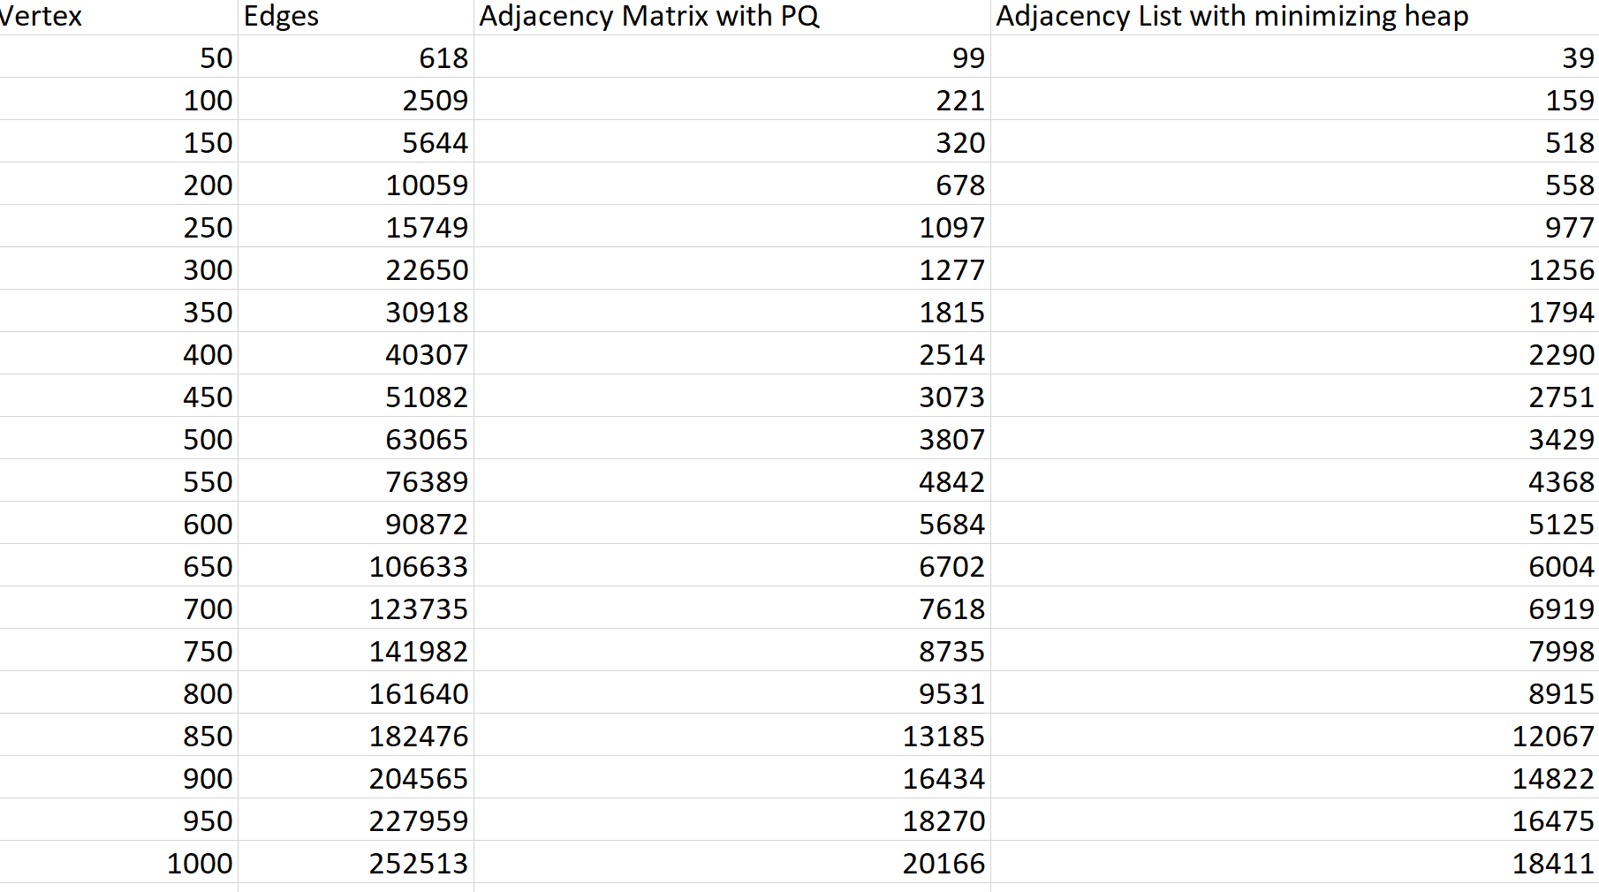
3. Comparing the CPU runtimes between part (a) and (b) with regards to number of edges and vertexes
Notes:
Average wise Adjacency List is better as there is a significant smaller number of edges present

Slide 18
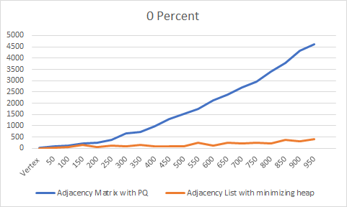
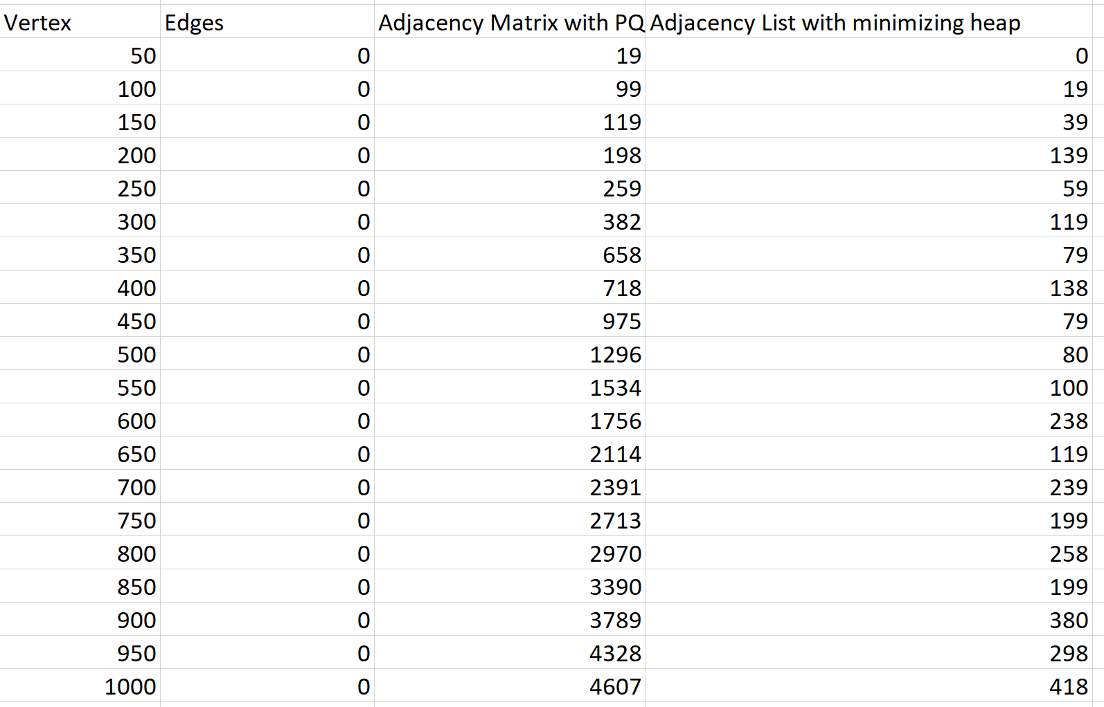
3. Comparing the CPU runtimes between part (a) and (b) with regards to number of edges and vertexes
Notes:
In conclusion, for a smaller number of edges, using the adjacency list would be better but however when faced with a larger number of edges, using the adjacency matrix would be better

Slide 19
THANK YOU FOR YOUR TIME!

Slide 20
CZ2101
Example Class 1
Team Member
Benjamin Goh (U2022728L)
Isaac Tan (U2020337B)
Jiang Yuxin (U2022749J)
Sep 1, 2021
1
Notes:
Good morning professors,

Slide 21
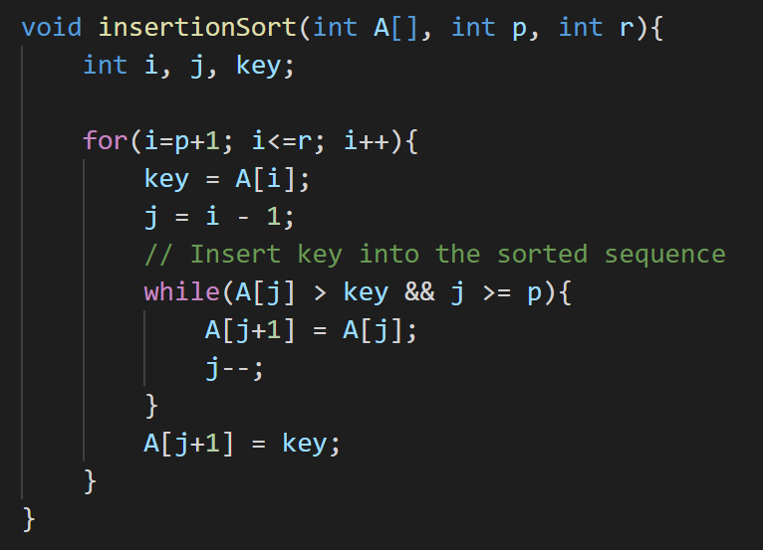
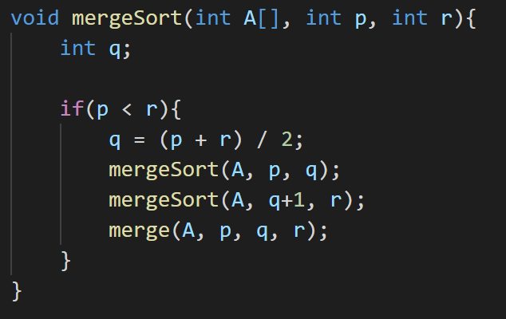
Project 1: Integration of InsertionSort & MergeSort
Implement & Analyze Hybrid Algorithm
Determine Optimal Value S
Compare MergeSort against Hybrid
Notes:
We will present the project in three parts: from the implementation, time complexity to optimal s, finally, comparison against mergsort.

Slide 22
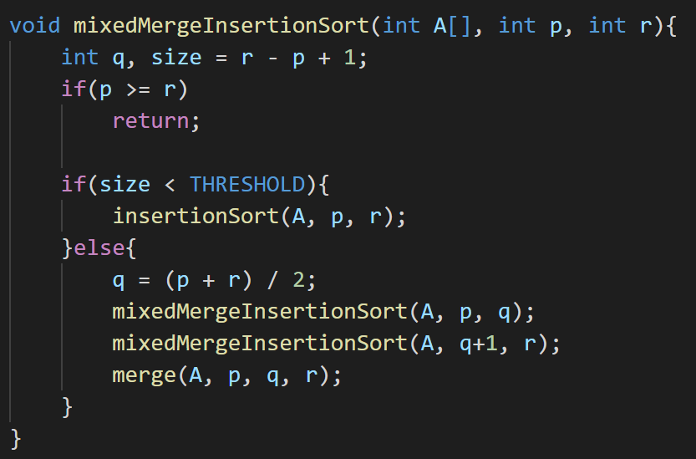
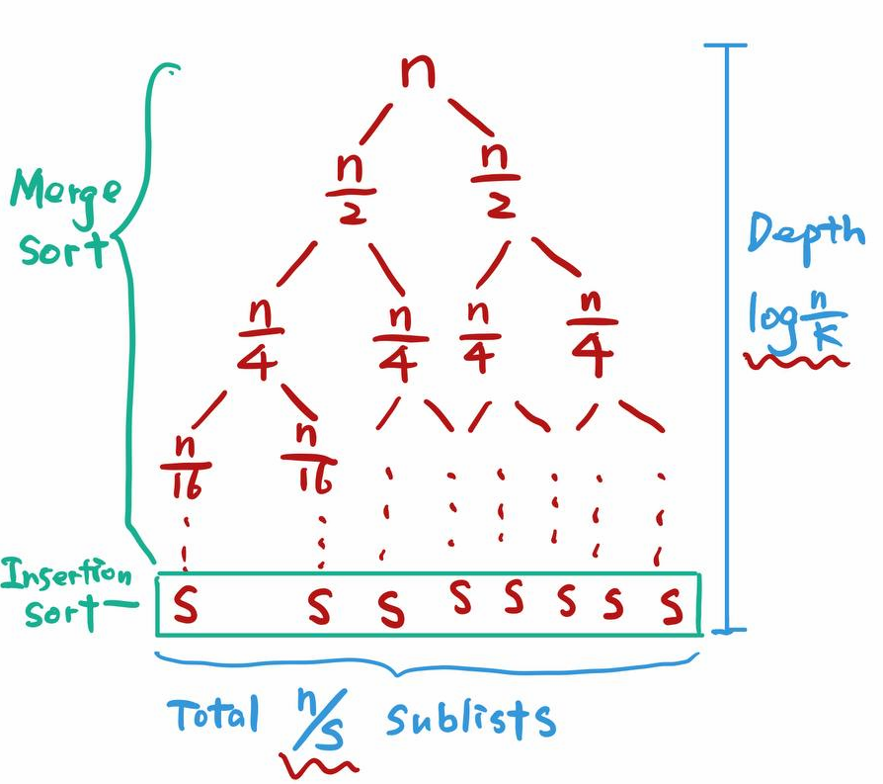
1. Implement Hybrid Algorithm
Recursion Tree
Notes:
The implementation is quite straight forwad. For merge sort, we recursively partition until only one or no element left, then start merge the resulting two subarrys. as for the hybrid algorithm, We just coarsen the leaves of the recursion. If the size of the array is less than the threshold value, which means subproblems become sufficiently small, we will use insertion sort. Here shows the recursion tree of the hybrid algorithm, which is similar to merge sort. But the depth of the trees is different, we have lg(n) minus lg(s), that is log(n/s). Obivously,from either the code or graph, the time complexity has two part. and We consider the complexity of the insertion part first.

Slide 23
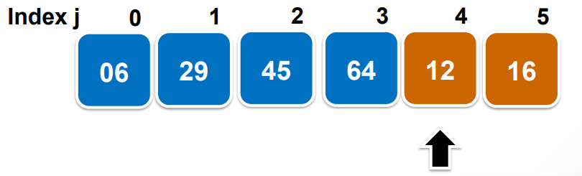
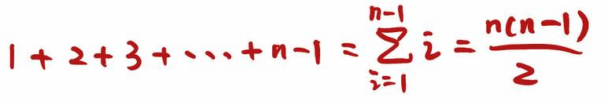

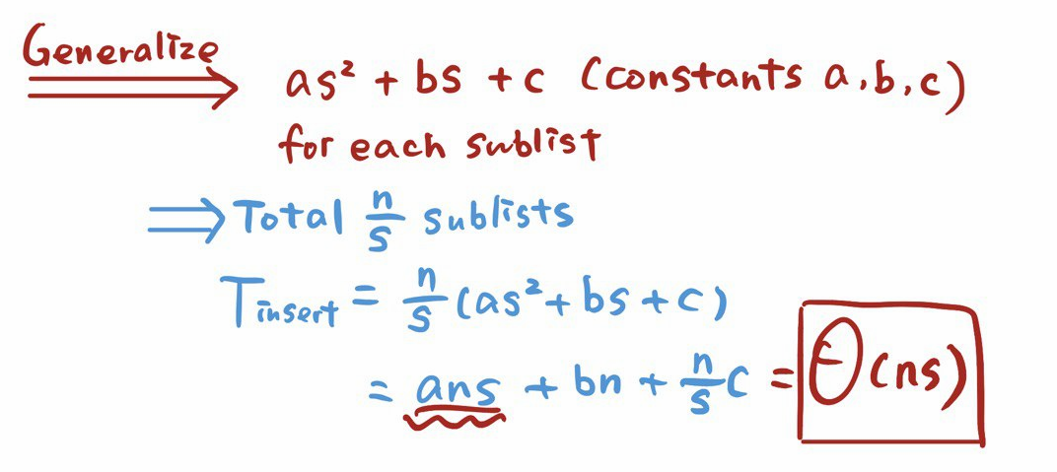

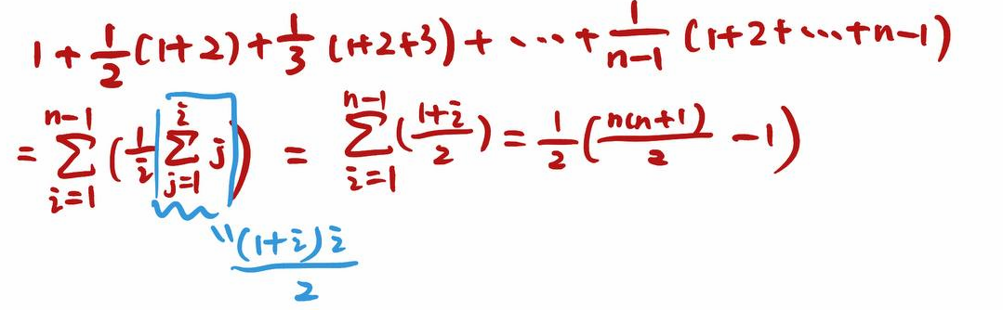
2. Analyze Time Complexity
(1) Sorting n/s sublists of length s
Worst Case:
i key comparision for the i-th iteration
Total:
Best Case:
1 key comparison per iteration
Total:
Average Case:
the ith iteration may have 1, 2, …, i key comparisons
each with 1 / i chance
Total:
Substitute s for n
Notes:
it is just the same as the insertion sort we have learnt in lecture. We can generalize these three cases into this polynomial equation with constants a, b, c, then substitute s for n. This is the time that sorting each list takes and we have n/s of those, thus, the time complexity of the insertion part is big theta n multiply s. (Note this is even for the worst case)

Slide 24
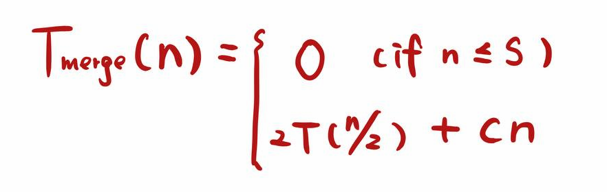
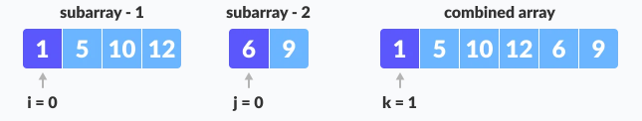
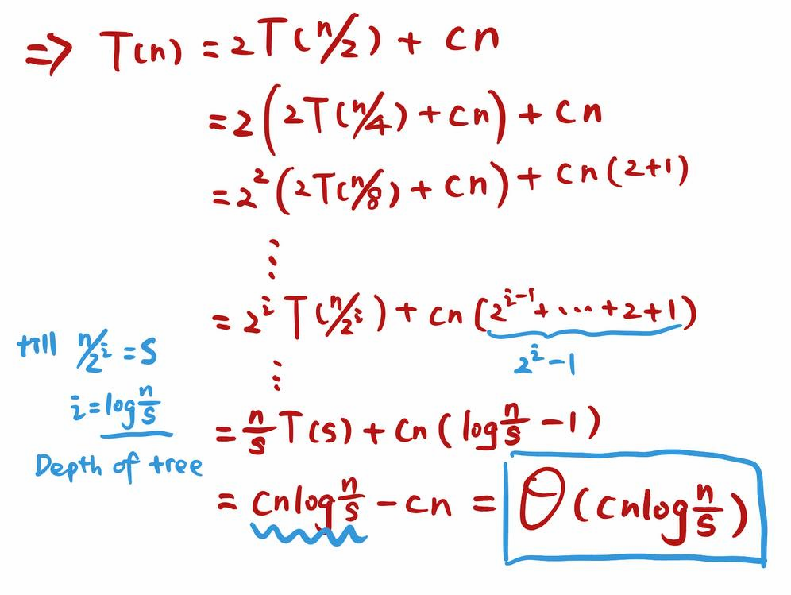

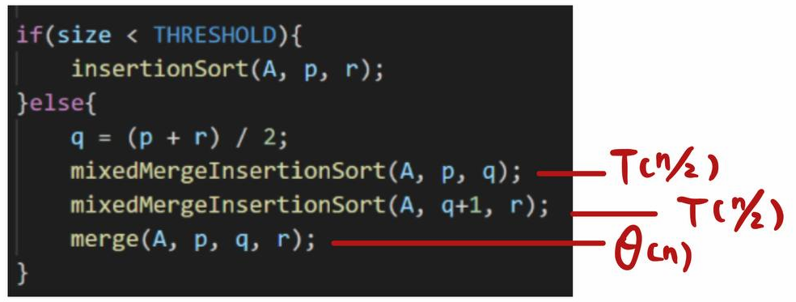
2. Analyze Time Complexity (tbc)
(2) Merging sorted sublists
(a) Merge
Worst Case: n - 1
Best Case: n / 2
(b) MergeSort
Notes:
So now we have n/s sorted sublists each of length s. As we mentioned before the depth of the tree is lg(n/s) and each level of the merge tree is linear time cn. as seen here the merge part. So putting it together, the merge sort takes time big theta cn multiply log n/s. Or we can use the method of backward substitution, which will give us the same answer.

Slide 25
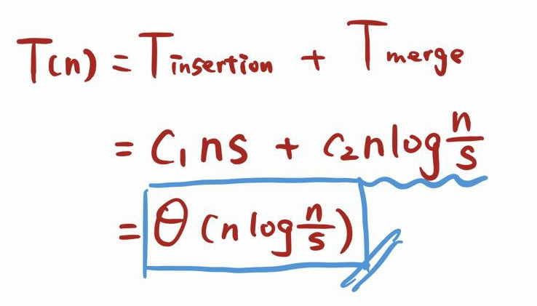
2. Analyze Time Complexity
(3) Overall Time Complexity of Hybrid Sort
Notes:
Eventually, we combine these two part together. n*logn/s is the dominant term and thus the running time of hybrid algorithom is big theta n* logn/s

Slide 26
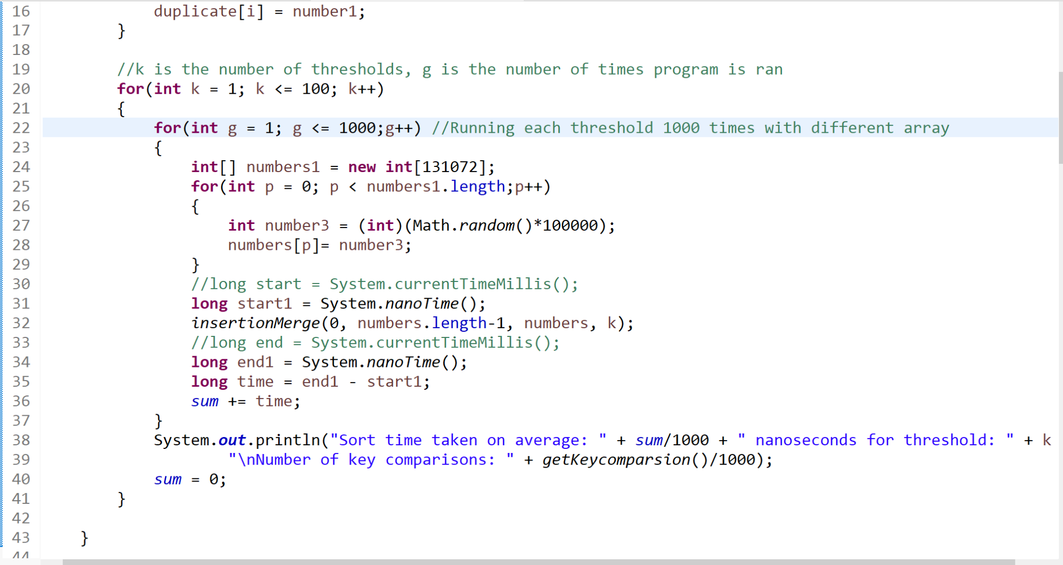
3. Analyzing the optimal S for Hybrid sort
Notes:
In order to find the optimal S we used the brute force method in order to find it. By running all the thresholds from 1 to 100, after which the program was ran 1000 times for each individual thresholds. We managed to find the optimal S value in which the array size n used was 131072 as shown by the code above.

Slide 27
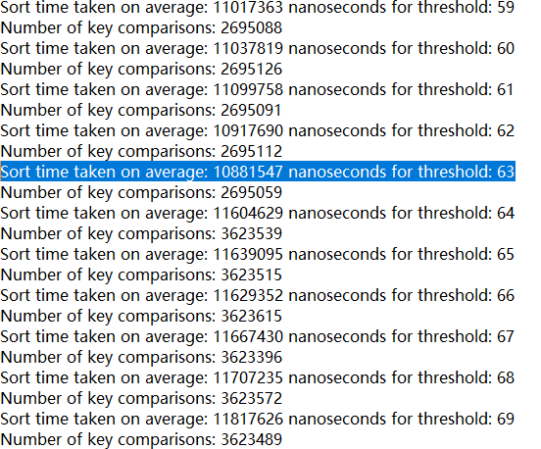
3. Determine Optimal S Value for Hybrid sort
Notes:
Optimal S value choosen is 63 based on the fact that it has the shortest runtime of 10.88 miliseconds out all of the thresholds from 1 to 100.

Slide 28
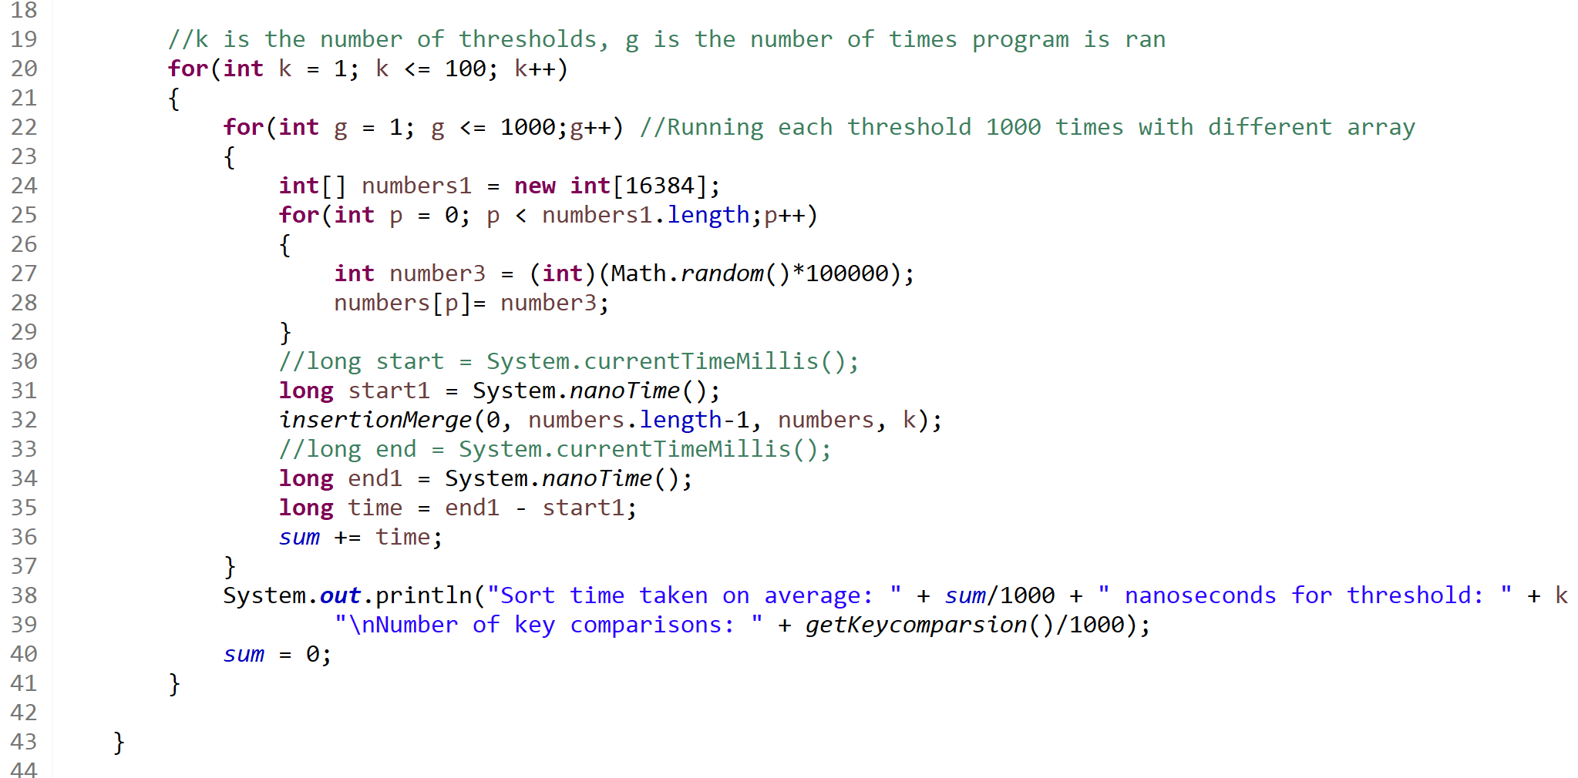
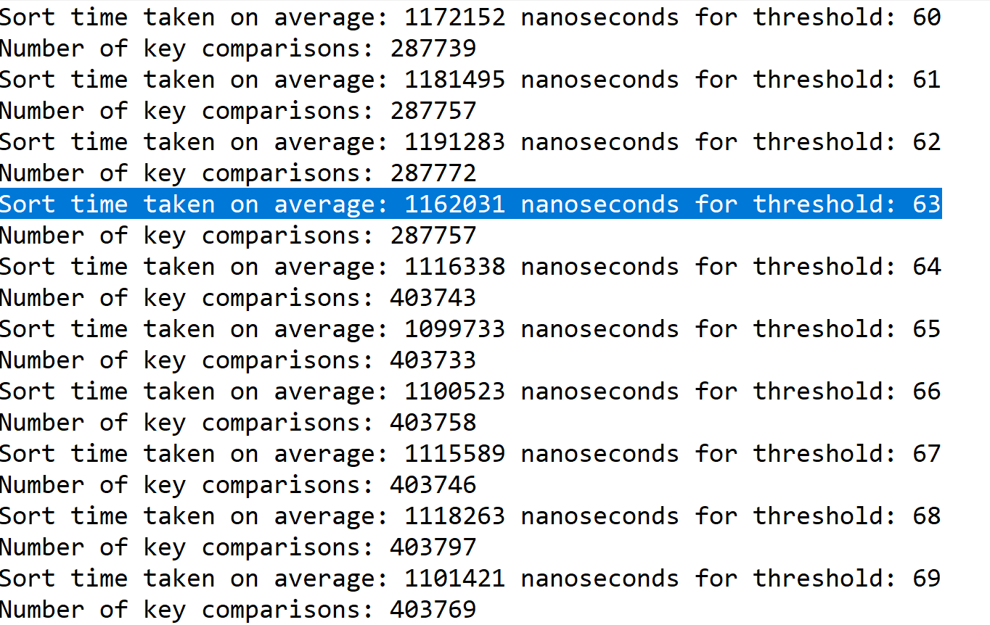
3. Using a different input size to check
Notes:
Now by using a different input size of 16384, we can see that the threshold 63 is still relatively faster as compared to the other thresholds therefore the optimal S was chosen as 63

Slide 29
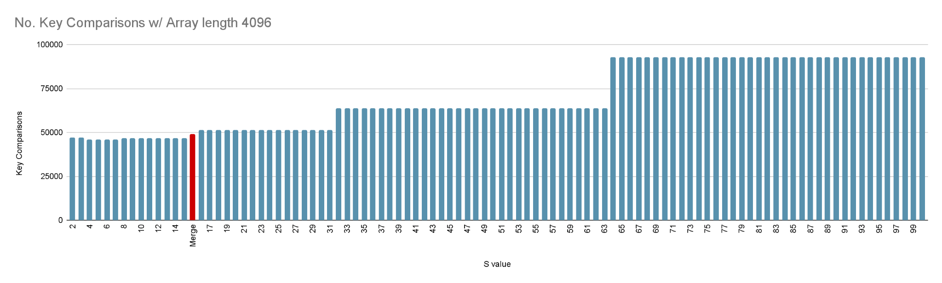
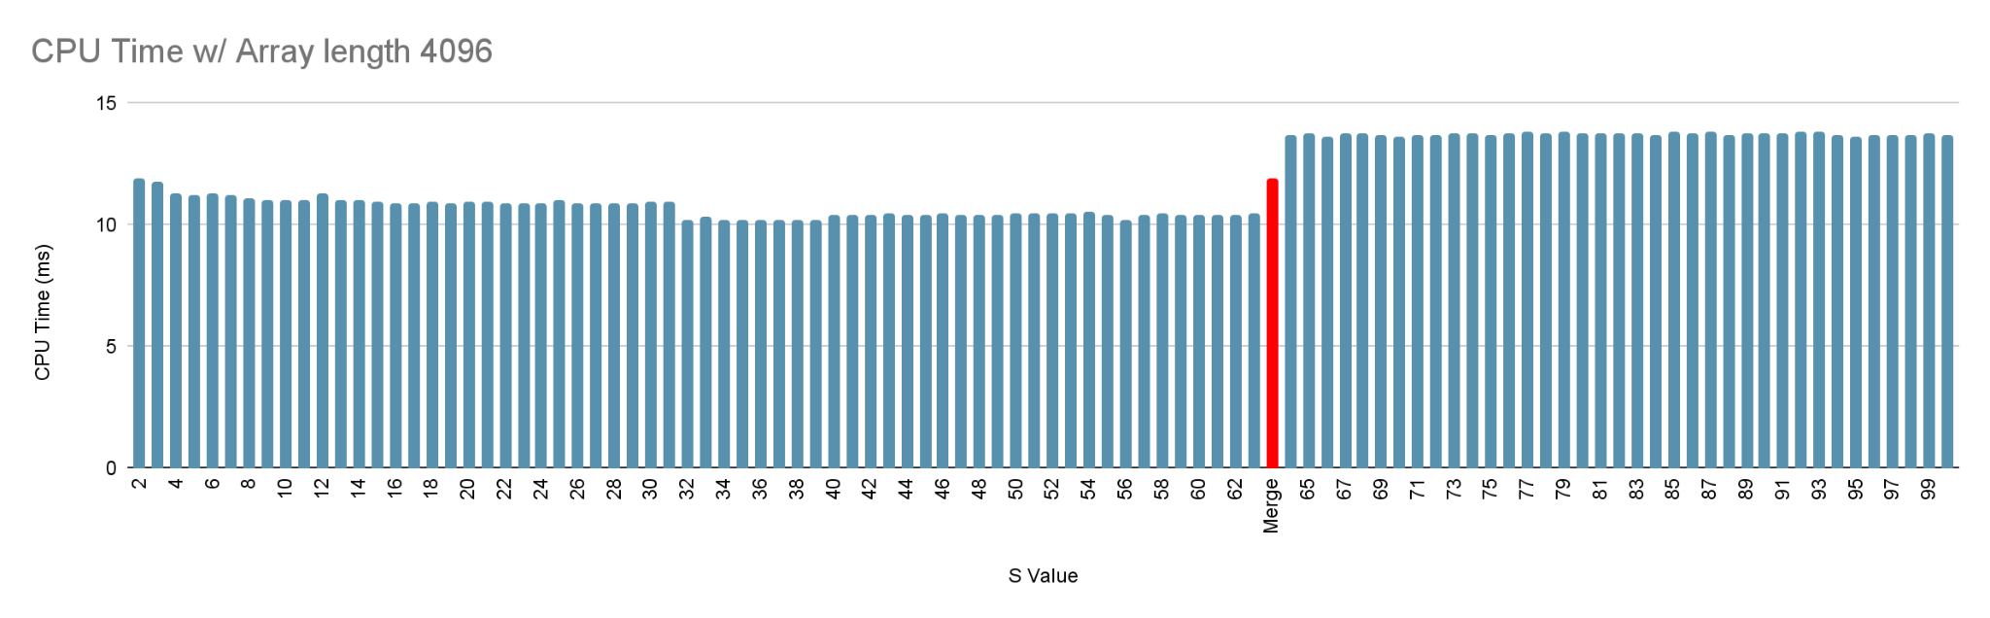
4. Comparing Merge & Hybrid sort

Slide 30
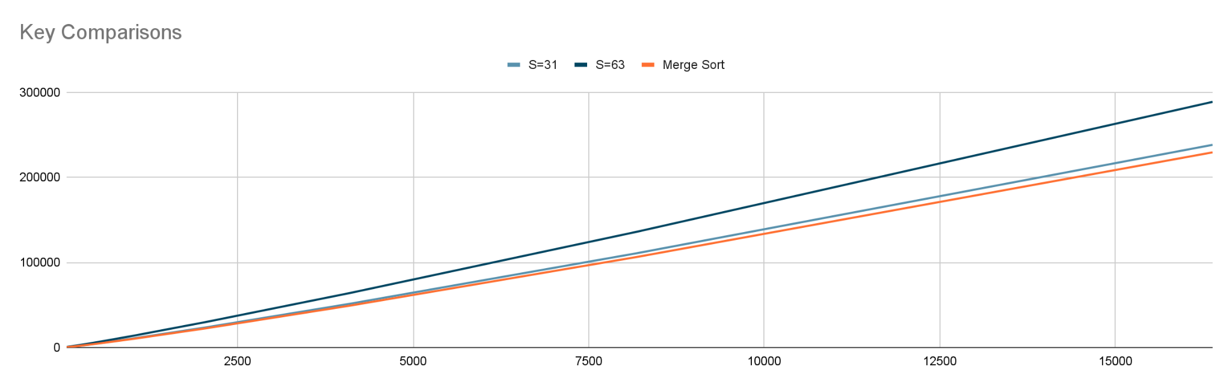
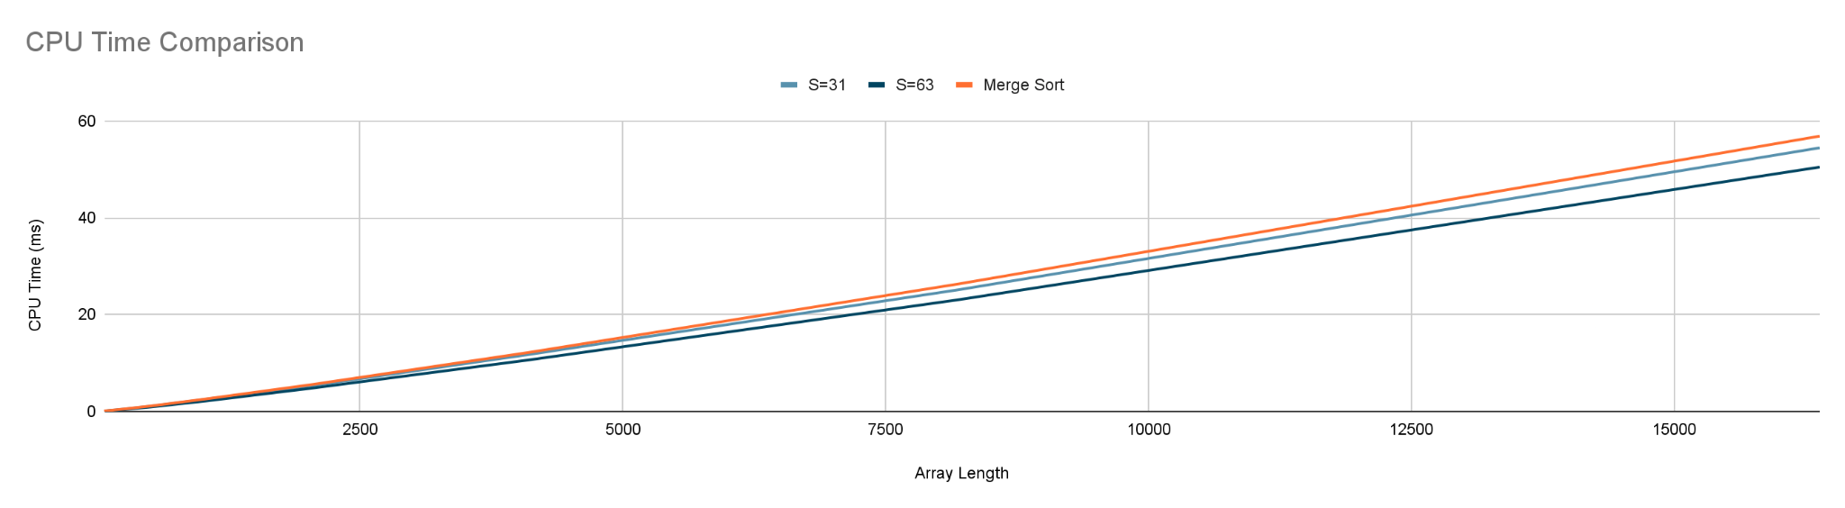
4. Comparing Merge & Hybrid sort

Slide 31
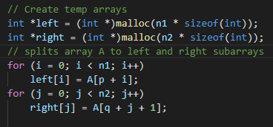
4. Comparing Merge & Hybrid sort
 | Key Comparisons | CPU Time (ms)
Merge Sort | 49152 | 11.38
Hybrid, S=31 | 63985 | 11.58
+30% key comps!
+2% CPU Time

Slide 32
THANK YOU FOR YOUR TIME!

